Slide 1
MEANING OF HEREDITY
Heredity may be defined as the transmission of characteristics through generations. The characteristics include all physical, physiological and psychological characteristics in organisms. All these characteristics are called the traits.

Slide 2
Mendel's Work
Gregor Mendel was the first to carry out scientific studies on transmission of characteristics from the parent to the offspring. He selected garden peas as they showed many contrasting traits that were easy to track through the generations. Moreover, these plants are naturally self-pollinated. This made it easy for getting pure lines. Pure line plants will produce only plants of their own type. That is, if a plant bears red flowers, the new plants from its seeds also will bear only red flowers.

Slide 3
Mendel's Work Cont…
Thus, these plants are pure for the red flower colour. For cross-pollination, Mendel opened the bud and removed the stamens. This is called emasculation. The emasculated flower was covered with plastic bag. When the flower opened, the stigma was dusted with the pollen of another flower. This produced crossbreeds.

Slide 4
Monohybrid Cross
In the first experiment, Mendel considered only one trait at a time. Some of the traits he considered were the height, flower colour, shape of the seed, etc. First he ensured that he had pure-bred tall and pure-bred short plants by selecting seeds from plants that had been self-pollinating for many generations. (Self-pollination is ensured by keeping the flower covered with plastic till seed formation). He selected one tall and one short plant from the pure-breds.

Slide 5
Monohybrid Cross Cont…
He called this the P or parental generation. He cross-pollinated the tall and short plants. In the first generation, he got all tall plants. This generation was called the first filial or F1 generation. Then the plants from F1 generation were self-pollinated and the next generation was called the second filial or the F2 generation.

Slide 6
Monohybrid Cross Cont…
In this generation, the ratio of tall to short plants was found to be 3:1. Of the tall plants, one-third was found to breed true and the other two-thirds on selfing again produced plants in 3:1 ratio of tall and short plants.
The plants that are produced in the F1 generation are called hybrids as they have a mixture of traits of both the parents. Since, in this case only one trait, i.e., height was considered, this cross is called the monohybrid cross.

Slide 7
Physical Basis of Heredity
According to Mendel, the genotype is made of certain structures called factors. The factors controlled the inheritance of all traits. These factors are present in pairs. The factors are now called genes. Thus the physical basis of heredity are the genes or factors. The different expressions of the same genes are called alleles. Each trait may be represented with an alphabet.

Slide 8
Physical Basis of Heredity Cont...
If the alphabet T represents height, T represents tallness and t represents shortness. If the letter R represents the colour of the flower, R represents red and r represents white.
General convention is to represent the dominant character or the character expressed in F, generation by capital letter.

Slide 9
Physical Basis of Heredity Cont...
Further, each individual for sexual reproduction produces gametes. Gametes are haploid. Each gamete will have only one allele for each trait. Thus the gametes will be of two kinds - having allele T or t. Since each individual is formed by the fusion of gametes, they are represented by writing two letters - TT, Tt or tt depending on their origin. If the plants are pure breeds producing only one type of offspring, they are called homozygous (TT or tt). If the plants produce both tall and short plants among the offspring, then they are heterozygous (Tt).

Slide 10
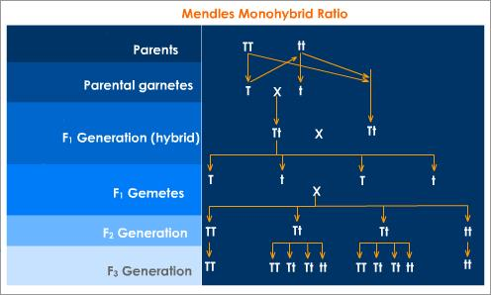

Slide 11
Physical Basis of Heredity Cont...
In case of height, the tall plants of P generation are represented as TT and the short plants as tt. Each parent produces only one type of gamete. Tall plants produce gametes having allele 'T' and short plants produce allele having 't' gametes. When these two types of gametes fuse, the resultant plants are heterozygous (Tt). However, only tallness is expressed, as all plants of this generation are tall.

Slide 12
Physical Basis of Heredity Cont...
Thus, tallness is the dominant allele and shortness is the recessive allele. Thus the recessive allele remains hidden in the first generation and becomes expressed on self-pollination in the next generation.

Slide 13
Physical Basis of Heredity Cont...
The F₁ generation plants are then self-pollinated. This results in tall and short plants in the ratio 3:1. This is called the phenotypic ratio. Of the tall plants, 1/3rd of the plants is homozygous for tallness and the remaining 2/3rd are heterozygous. The heterozygous plants on self-fertilization again result in offspring that show 3:1 ratio for tallness to dwarfness.

Slide 14
Physical Basis of Heredity Cont...
Thus the genotypic ratio in the F₂ generation is 1:2:1. This means that 1/3rd are tall and homozygous, 2/3rd are tall and heterozygous and 1/3rd are dwarf and homozygous. Note that recessive traits are phenotypically expressed only in the homozygous genotype.

Slide 15
Physical Basis of Heredity Cont...
Similar crossing experiments were also carried out with more than one trait. However, it is not possible to follow all the traits at the same time. The other traits studies by Mendel in garden pea were colour of the seed, the shape of the seed, colour of the seed coat, the flower colour, flower position, pod colour and pod shape.

Slide 16
Physical Basis of Heredity Cont...
The crosses that study two traits together are called the dihybrid crosses. In the dihybrid crosses, it was found that the two traits were inherited independent of each other. The dominant alleles for each of the two traits asserted their dominance independent of the other.

Slide 17
Laws of Inheritance
Mendel explained the mechanism of inheritance with the help of laws he formulated based on his experiments. These laws are:
Law of unit characters
Law of Dominance
Law of Segregation
Law of Independent Assortment

Slide 18
Law of Unit Characters
According to this law, all the traits are separate entities or units by themselves. Their inheritance is controlled by factors, now called genes.

Slide 19
Law of Dominance
Each gene has more than one form of expression. These forms of expressions are called alleles or allelomorphs. Each pair of alleles will have a dominant allele and a recessive allele. In the presence of the dominant gene, the recessive gene will never express itself. Only if both the alleles are recessive, the recessive trait will be exhibited.

Slide 20
Law of Segregation
This is also called the law of purity of gametes. According to this law, the gametes are pure for a particular trait. This is because the alleles of a pair separate during gamete formation and again come together after fertilization. Therefore, in each gamete only either of the two alleles is present and it is pure for that trait.

Slide 21
Law of Independent Assortment
This law explains how more than one trait is inherited. According to this law, when there are two pairs of alleles, all four alleles assert themselves independently and are inherited independently.

Slide 22
Theory of Inheritance
Waldeyer is credited with the discovery of chromosomes in the year 1888 within the nucleus. He observed them as darkly stained bodies. However, it was the American William Sutton who noticed the similarities between the behaviour of the mendelian factors or genes and that of the chromosomes during meiosis. He noticed the following similarities:

Slide 23
Theory of Inheritance Cont…
Both occurred in pairs - genes as alleles and chromosomes as homologous chromosomes.
Both separated from the pairs and entered the gametes independently - each gamete received only one of the alleles of a pair and also received only one of the homologous chromosomes during meiosis.
The pairs of both are restored during fertilization - the zygotes receive one allele each from the two parents through the gametes and the zygotes also receive the two homologous chromosomes, one from each parent, during fertilization.
The above observations led Sutton and Boveri to formulate the Chromosomal theory of inheritance, independently in 1902. According to this theory,

Slide 24
Theory of Inheritance Cont…
Each adult organism grows from a zygote. The zygote is a diploid cell having two sets of chromosomes - maternal and paternal. The zygote by mitotic divisions results in the formation of an adult and thus, all the vegetative or somatic cells of an organism are diploid with two sets of chromosomes.
The chromosomes maintain their individuality through out the life cycle of the organism.
The chromosomes contain the Mendelian factors or genes, which determine the various characteristics of an individual.
It was later discovered that the genes are arranged in a linear manner on the chromosomes.
The position of a gene on the chromosome is called the locus. It always remains the same for a gene.
The alleles of a gene are present on the homologous chromosomes at the same loci.

Slide 25
Genetic Material
The genetic material is a nucleoprotein called chromatin. It is made up of DNA and protein.
DNA or Deoxyribonucleic Acid
It is a double stranded molecule with each strand being made up of many nucleotide units. Each nucleotide is made up of a nitrogenous base, a sugar molecule and a phosphoric acid molecule. Nitrogenous bases are of two kinds:
purines
pyrimidines
The nitrogenous bases present in DNA are adenine and guanine, which are purines and cytosine and thymine, which are pyrimidines. The sugar molecule present in DNA is deoxyribose. The nitrogenous base, sugar and phosphoric acid together join to form a nucleotide that looks like this:

Slide 26
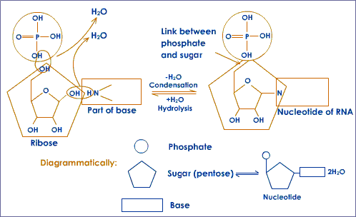
Formation of a Nucleotide

Slide 27
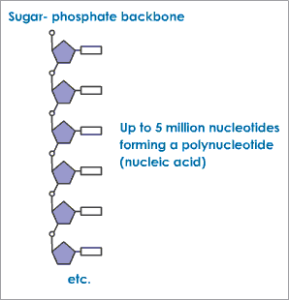
Formation of Polynucleotide

Slide 28
Each DNA molecule has two such polynucleotide chains joined to each other by hydrogen bonds. The hydrogen bonds are between the nitrogenous bases of the opposite nucleotides.

Slide 29
Double Helix DNA Structure
If the polynucleotide chains are the sides of the ladder, the bonds can be compared to the rungs of the ladder. The whole molecule can be likened to a rope ladder twisted around to from a helical structure. The DNA molecule is twisted around a core of proteins.
Short chains of the DNA form the genes. Each gene is, therefore, a series of nucleotides in a particular sequence. Each gene codes for a particular trait. The genes are arranged in a linear manner on the chromosomes.

Slide 30
DNA and Genetic Engineering
The complimentary property of the nucleotides of DNA has been proved to be the most powerful tool of genetic engineering. After cutting a segment of DNA or gene with the help of specific enzyme, it can be joined or attached with the DNA of a different organism. Such type of organism that contains a segment of foreign DNA or gene, is known as transgenic organism, or genetically modified organism (GMO).

Slide 31
Sex Chromosomes
During the formation of gametes, the females will have only one type of gametes, all with one X chromosome. However, the males will produce two types of gametes or sperms, half with X chromosome and half with Y chromosome. Thus the sex of a zygote is determined by which male gamete fuses with the female gamete.

Slide 32
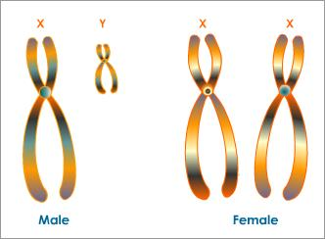
Human Sex Chromosomes

Slide 33
Sex Chromosomes
If the X gamete fuses with the female gamete (also X), the zygote will be a female. If the Y gamete fused with the female gamete, the zygote will be a male. This type of sex determination is called XX-XY type.

Slide 34
Variation
Variation may be defined as differences among individuals of a species. All around us we see different organisms belonging to different species. Within each species too, no two individuals are identical to each other. Asexual reproduction produces identical offspring called clones and identical twins are seen in sexual reproduction. However, clones and identical twins can also differ from each other if subjected to different environmental conditions.

Slide 35
Variation Cont…
Variations arise either due to environmental influence or genetic factors. The environmental factors like the food, temperature, etc. influence the phenotype of individuals. However, phenotypic changes are not heritable. Genetic changes are those that affect the genes. These changes are heritable and important from the evolutionary point of view.

Slide 36
Types of Variations Variations can be classified based on the origin:
Somatogenic
They are somatic and non-inheritable. They are caused by the influence of the environment upon the somatic cells.
For example
Strong sunlight causes skin to darken in human
Honeybee larvae fed on royal jelly become fertile and others that are not become sterile. The fertile larva becomes the queen and the others become workers.
Continuous exercise makes the muscles of a sportsmen strong and well developed.
Chinese women wear tight shoes in order to get small feet.
In all the above cases, the changes are not heritable and are caused due to changes in the environment.

Slide 37
Blastogenic
There are changes that occur in the genes of the organism. These changes may be heritable. The changes may be due to assortment of genes during meiosis in sexual reproduction or due to some sudden change in the composition of genes or chromosome number. An example of change due to meiosis is the difference in height of a population. An example of change in the number of chromosomes is Down's syndrome where there is an extra 21st chromosome.

Slide 38
Blastogenic Cont…
The individual is mentally retarded, has moon face, thick lips and generally does not live to the reproductive age. An example of change in the gene structure is sickle-celled anaemia. In this, one of the genes undergoes a change in its composition. This results in the red blood cells being sickle shaped. It is a fatal disease. Variations may also be classified as continuous and discontinuous.

Slide 39
Continuous Variations
Continuous variations are minute and non-hereditary. They may be due to influence of the environment or genetic. For example, variation in height of a human population, number of arms in a starfish, etc.

Slide 40
Discontinuous Variations
Discontinuous variations are large and prominent. They are due to mutations. For example, six digits in man, tailless kitten, hornless calf, etc.

Slide 41
Significance of Variations
Variations provide the species a way to survive and adapt to the changing environmental conditions. Since there are variations, nature can choose the best suited individual and allow the species to multiply further. Thus, natural selection is possible only because of variation.
Man has also made use of variations. It is because of variations that he is able to improve the animals and plants that are useful to him.

Slide 42
Evolution
Evolution may be defined as a gradual development of more complex species from pre-existing simpler forms. It is an extremely slow process and has occurred over millions of years. Evolution that has occurred is clear because of the evidences of fossils, etc. However, the mechanism of evolution has not satisfactorily been explained.
This problem has been fascinating scientists and philosophists since the early times.

Slide 43
Theories of Evolution
Some of the formal theories on evolution are:
Lamarckism
Use and Disuse of Parts
Inheritance of Acquired Characters
Theory of Continuity of Germplasm
Darwinism
Neo-Darwinism

Slide 44
Lamarckism
The theory of evolution as put forth by French biologist Lamarck has come to be known as Lamarckism. This theory has two salient features:

Slide 45
Use and Disuse of Parts
According to Lamarck, continuous use of a part results in it being well-developed and disuse of a part over a long period of time will result in its degeneration. For example, giraffes were forced to extend their necks and stretch their legs to reach higher vegetation over a period of time. This resulted in every generation having a little longer neck and legs than the previous one. Webbed feet in aquatic birds are thought to have developed due to constant spreading of toes and the stretching of the skin between. Flatfish also are thought to have developed their shape due to lying on their sides in shallow water.

Slide 46
Inheritance of Acquired Characters
According to Lamarck, the characters that an organism acquired due to a change in their environment such as long neck, webbed feet, flat bodies, etc. were passed on to the next generation. In this way, evolution from simpler to complex forms took place.
However, this theory was not widely accepted as it is known that acquired characters are only phenotypic changes and not genotypic. Thus, while the cases of giraffe, aquatic birds and flatfish do show that evolution has occurred, Lamarckism does not provide a satisfactory answer to the mystery of evolution.

Slide 47
Theory of Continuity of Germplasm
This was proposed by Weismann who did not agree with Lamarck's theory of inheritance of acquired characters. To prove his point, he cut off the tails of many successive generations of mice. This resulted in forced disuse of the tail. According to the theory of use and disuse, the tails should have become progressively shorter. However, this did not happen.
According to Weismann, the changes affected only the somatic (vegetative) cells and did not affect the germ cells or the gametes. Only the changes that affect the germ cells and the germplasm (the collection of genes) will be inherited by successive generations.

Slide 48
Darwinism
The theory of natural selection was put forth by Charles Darwin in his book 'On the Origin of Species by Means of Natural Selection', co-authored by Alfred Russel Wallace. According to Darwin, nature has its own ways of selecting the best from the available species for continuation of life. The mechanism of natural selection works as follows:

Slide 49
Individuals of a species produce more offspring than necessary to replace themselves.
This results in competition and struggle for existence among the individuals. Within the species itself there is variation that results in minor differences between the individuals.
Thus in the struggle for existence only the ones with the variations best adapted to their environment survive.
In this manner nature ensures survival of the fittest.

Slide 50
Neo-Darwinism
The theory put forth by Darwin and Wallace gained wide acceptance. However, in the light of modern evidences, it was slightly modified and called the neo-Darwinism. In neo-Darwinism, organic evolution is by natural selection of inherited characters. It utilises evidences from various fields such as genetics, palaeontology, molecular biology, ecology and ethology (study of behaviour).

Slide 51
Evidences of Evolution
Inspite of many evidences, studies and theories, we are still not aware of how the evolution actually occurs. The search for this knowledge continues. The various sources from which evidences are available for studying the mechanism of evolution are:
Palaeontology
Geological Distribution
Comparative Embryology

Slide 52
Palaeontology
Study of fossils is called palaenotolgy. Fossils are defined as preserved remains of a living organism that existed on earth a long time ago. Fossils are formed by the preservation of the remains of the organisms that existed in the earlier days. The dead bodies of the organisms are immediately covered by materials which do not allow decomposition at a fast rate. This preserves the dead bodies which form fossils. For example, we know of the existence of dinosaurs only through fossils.

Slide 53
Palaeontology Cont…
In addition to knowledge about the extinct forms, fossils also provide links between two groups indicating that perhaps one species evolved from the other. For example, a fossil called archaeopteryx show features of both reptiles (teeth) and birds (wings).

Slide 54
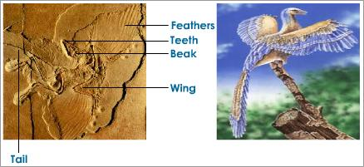
.
The Fossil of the ArchaeopteryxArchaeopteryx the Connecting Link between Reptiles and Birds
Thus it provides a link between birds and reptiles.

Slide 55
Geological Distribution
The organisms show particular patterns of distribution on earth. The distribution of the species give an indication of how the earth was earlier. It is believed that the earth was a single mass called the Pangea. It consisted of two large continental masses called Laurasia and Gondwanaland that were interconnected by land bridges. These land masses have continuously drifted away from each other. This theory was proposed by Alfred Wegener and called the theory of continental drift. A proof of this comes from the distribution of lungfish. As can be seen in the maps below, the regions where the lungfish is presently distributed were all close together in the early days.

Slide 56
Comparative Embryology
Haeckel (1834-1919) formulated that 'ontogeny recapitulates phylogeny'. This means that the developmental stages that an organism goes through repeat the evolutionary history of the group to which the organism belongs.

Slide 57
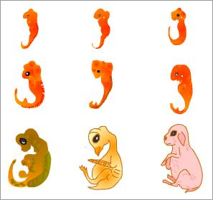
.
Stages in Embryological Development

Slide 58
.
Though it does not explain the mechanism of evolution, the study of the embryos and their development reveal that at the embryonic stages there are features that are absent in the adult form. These features are common to a group of organisms. For example, At a particular stage, all the vertebrate embryos possess a single circulation with two-chambered heart showing no separation into right and left halves.
As the development progresses, the embryos change according to group they belong to - fish, amphibian, reptile, bird or mammal. The above situation is retained only in the fish and all other vertebrates deviate from this.

Slide 59
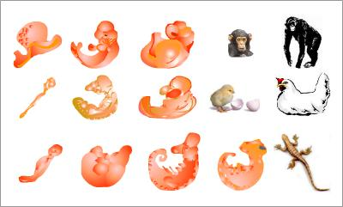
Given below is another example of the embryological evidence that certain animals have a common ancestor:

Slide 60
Heredity and Evolution Summary
All these evidences point to the fact that evolution occurs. The exact mechanism of evolution, however, is not yet conclusively proven. But constant study and research in the above fields is continuing for answers.
Asexual reproduction results in identical offspring whereas sexual reproduction results in variation among the offspring and also between parents and the offspring.
Heredity may be defined as the transmission of characteristics through generations.
Variation may be defined as differences among individuals of a species.
Both heredity and variation play important roles in evolution of organisms.
The study of the mechanism of transmission of characteristics from parents to the next generations is called genetics.
Gregor Mendel was the first to carry out scientific studies on transmission of characteristics from the parent to the offspring.

Slide 61
Heredity and Evolution Summary Cont…
Based on the experiments he conducted, Mendel came to the conclusion that there are certain physical entities called the factors that are responsible for the transmission of characters. These factors are now called genes.
There are various laws of genetics also based on Mendel's work.
These laws explain the dominance of certain traits, the haploid nature of gametes and their independent assortment.
Inheritance, according to the chromosomal theory, is due to the passage of genes that are present on the chromosomes that are passed on from the parents to the offspring.
The genetic material is made up of the chromatin or the chromosomes. These contain the genes that are arranged in a linear fashion. Each gene is a short chain of nucleotides arranged in a specific sequence.

Slide 62
Heredity and Evolution Summary Cont…
Each chromosome consists of two strands called the chromatids that are held together by the centromere.
The location of the centromere decides the shape of the chromosome.
Each organism contains a fixed number of chromosomes in each of its cells. The chromosomes in each cell are of two types - autosomes and sex chromosomes. Males have X and Y sex chromosomes whereas females have X and X sex chromosomes.
Variations are of many types. Based on whether they are phenotypic or genotypic, they are called somatogenic and blastogenic.
If the variation among a group of organisms is large and very obvious, it is called discontinuous and if it is small, it is called continuous.

Slide 63
Heredity and Evolution Summary Cont…
Variations play an important role in evolution, especially those that are inheritable.
Evolution may be defined as a gradual development of more complex species from pre-existing simpler forms. Some of the formal theories on evolution are Lamarckism, Darwinism, theory of inheritance of germplasm and neo-Darwinism.
According to Lamarck, parts that are continuously used develop well and those that are not used get degenerated. These acquired characters are then inherited. This theory is not very widely accepted.
Weismann proposed the theory of continuity of germplasm, only the changes that affect the germ cells and the germplasm (the collection of genes) will be inherited by successive generations.

Slide 64
Heredity and Evolution Summary Cont…
Darwin proposed the theory of natural selection. According to this theory, the reproduction in large numbers resulted in a struggle for existence and competition. This leads to survival of the fittest. Thus the best of the genetic combinations is preserved and passed on to the next generation as only the species that survive reach the reproductive age.
Due to the recent scientific advances by man, there are many more evidences that are coming to light. A study of all these evidences taken from various fields such as paleontology, comparative anatomy, geological distribution, embryology, etc. in search of the exact mechanism of evolution constitutes neo-Darwinism.

